Slide 1
Facebook for Beginners
Thurs July 31st 2014
Instructors:
Anne Swanson
Wyatt Fertig

Slide 2
We’ll cover:
Basics of Facebook
Signing up for Facebook
Layout
Editing your Profile
Facebook’s Features
Introduction

Slide 3
Online social networking tool, started in 2004 by Mark Zuckerberg and his college roommates at Harvard. (Feature film about it: The Social Network)
Allows users to:
Create profiles, with optional images
List interests, contact information, life events, school , employer
Send private or public messages, and chat
Post links to articles, images, videos
What is Facebook?

Slide 4
Facebook is great for connecting with friends, but also can be used as a great promotional tool for a business, organization, or brand
Facebook offers so many services that it can be overwhelming to first-time users, but after a short amount of time, using it becomes second nature
Here at EPL

Slide 5
Facebook is a great tool for those who want to increase contact with friends, family, and acquaintances
Facebook is often used for business purposes, allowing for news to be spread easily and rapidly
Examples of people you might connect with include: old high school friends, members of a book group, or church congregation
Facebook is for?

Slide 6
To sign up for a facebook account you’ll need:
An email address
A phone you have access to while on the internet
Following filling out the initial information, facebook will try to connect you to friends through your email address and your phone (mobile) -- feel free to skip these steps if not interested.
Signing up

Slide 7
My Profile
Friending, Messages and Notifications
Menu
‘favorites’
Newsfeed
Layout

Slide 8
Your newsfeed is the default view of facebook when opened.
The center portion of the screen will display the activity of facebook friends and organizations. The more popular a post is, the more likely it will show up in other feeds.
Also of note, facebook has recently added advertising into the feed itself.
Newsfeed

Slide 9
To start editing a profile, hit the update info in the top right corner.
To change or edit a profile picture or cover, hover over the picture itself to bring up these options.
Editing your Profile

Slide 10
The bread and butter of facebook is the facebook post.
Here you can post a message, update, photo and much more to your wall or another facebook user’s wall
You can also include who you are with, where you are located, and how you are feeling (if you want to!)
Posting

Slide 11
The two ways to send a personal message through facebook are messages and instant messages
Messaging will send a letter-like message to a profile
Instant Messaging or “Chat” opens up online conversation with friends online
Messaging
Instant messaging
Messaging vs Instant Messaging

Slide 12
One of the most useful features of facebook is its event page. Any events you are invited to are listed here by date. This is also the location to create and manage an event.
Events

Slide 13
For profiles of celebrities, businesses, clubs, and institutions, Facebook requires ‘pages’ instead of profiles.
Instead of friending a celebrity, instead you ‘like them’ and this will subscribe you to their content.
Pages

Slide 14
Check how your profile looks to a specific person and to the public: Click on lock at top-right
Group friends into lists
You can opt out of social ads: Account Settings/Ads & Friends
Set up who can see your posts: Account Settings/Privacy
Review photo tags of you: Account
Settings/Timeline & Tagging
Block bullies/pests
Always log out
Security/Privacy

Slide 15
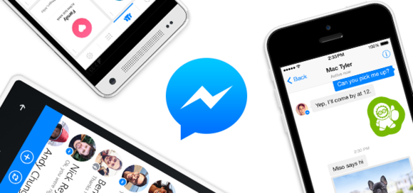
Facebook is also available in app format through the facebook app and the facebook messenger app.
Mobile Apps

Slide 16
There’s so much to do on facebook and so many people that it’s easy to get sucked in.
Coming up with a plan to limit time is not unusual for regular users.
(especially with facebook games))
Spending Your Time

Slide 17
Social Media for Small Business
Wednesday September 24th 6:30 p.m.
And want to start using LinkedIn –try
LinkedIn for Beginners
Wednesday October 1st 7 p.m.
Join us next time for

