Slide 1
Ancestry Library Edition Basics: US Focus
Brought to you by ProQuest

Slide 2

Agenda
What is Ancestry Library Edition?
What is (and is not) in Ancestry Library Edition?
Live Demonstration
  Basic vs. Advanced Search page
  Researcher’s tools
  Results page
  Image viewer
  Save, print, and email options

Slide 3
What is Ancestry Library Edition?
Ancestry Library Edition delivers an online collection of billions of indexed names and millions of records of individuals from North America, Europe, Australia, and more found in over 7,900 datasets covering 1300 to modern day.
Searchers can uncover family records and begin to trace their history with valuable personal information not found anywhere else.

Slide 4
The most commonly asked question?
What is the difference between my library’s Ancestry Library Edition resource and my at-home Ancestry.com subscription???

Slide 5
Some (but not all) differences in content between the two
There are certain databases or collections that are available in Ancestry.com, but are NOT included in Ancestry Library Edition (ALE):
Obituary Collection - The collection contains recent obituaries from hundreds of newspapers, but newspaper titles offered by ProQuest are not included in ALE.
Historical Newspaper Collection - These are mostly small town newspapers, and most do not have complete series / coverage.
ProQuest’s Genealogy & Local History Books in the Families and Local Histories Collection - Digitized from UMI’s Genealogy & Local History Books microfilm collection, these titles are found in HeritageQuest Online, available from ProQuest.
Periodical Source Index (PERSI) - This database is found in HeritageQuest Online, available from ProQuest.
Freedman’s Bank Records - This database is found in HeritageQuest Online, available from ProQuest.

Slide 6
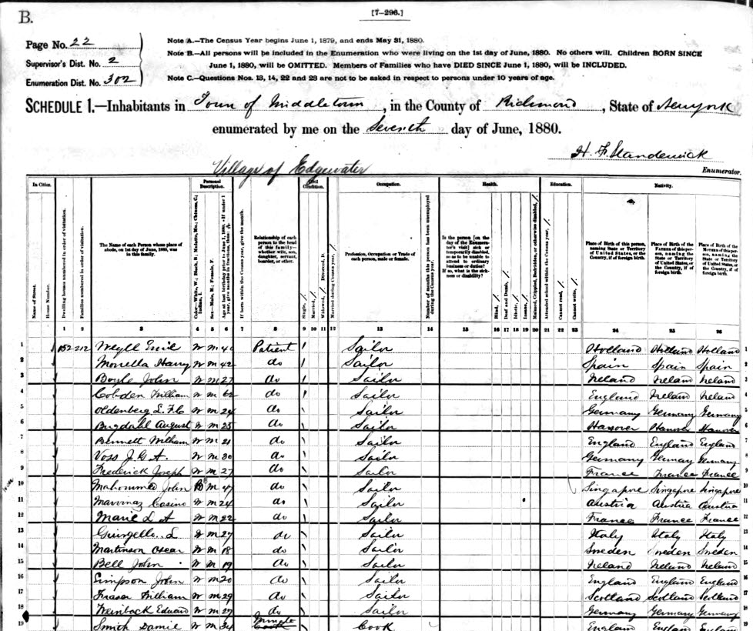
Ancestry Library Edition contents
Census Data
Incredible U.S. coverage
  Over half a billion records
  Covers 1790 to 1940
  Every name indexed, searchable
  Slave schedules, state records, and more
Extensive Canadian coverage back to mid-19th century
Extensive UK coverage back to 1841
1930 Mexico National Census

Slide 7
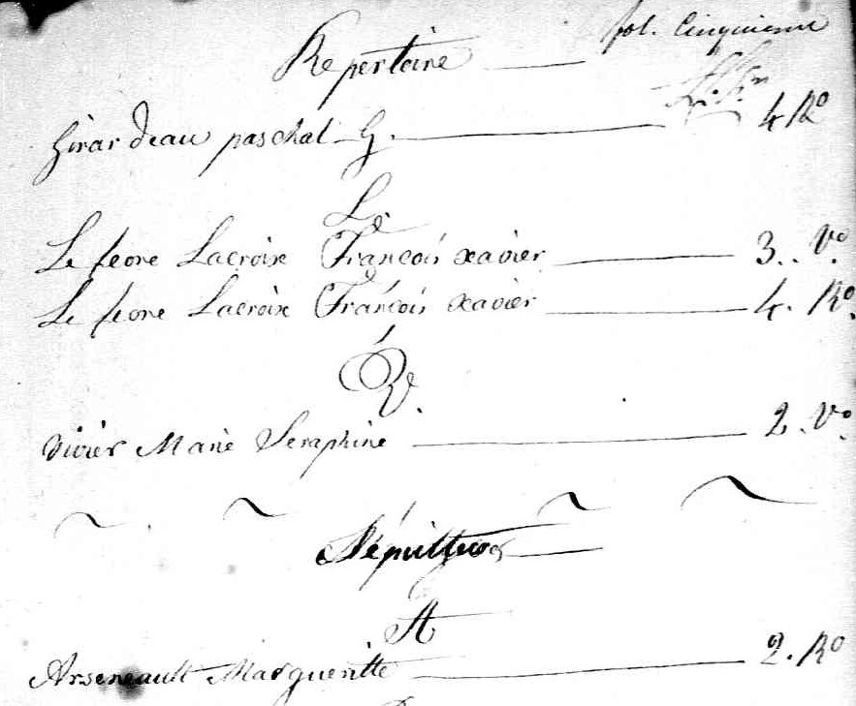
Ancestry Library Edition contents
Vital Records
U.S. Social Security Death Index with 80M+ records
Over 100 million U.S. state birth, marriage, and death records back to the 1800s
30 million+ Canadian birth, marriage, & death records back to the 1600s
Nearly 400 million UK vital records back to 1837

Slide 8
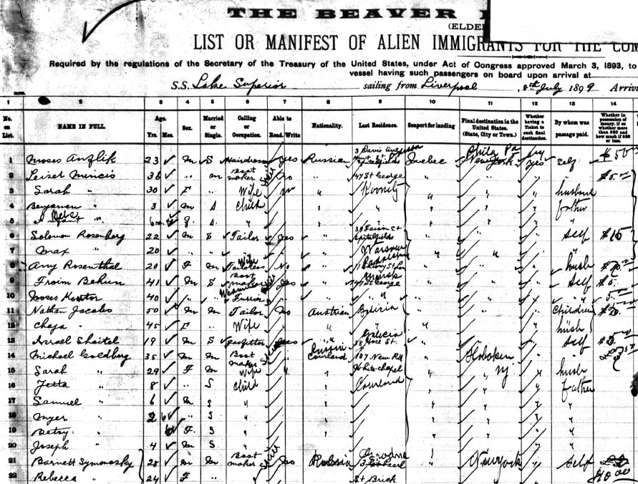
Ancestry Library Edition contents
Immigration Records
Passenger Lists
  200 million+ records
  Includes all major US ports, Canadian ports, UK ports, and other European ports
Border Crossings
  Between Canada & U.S., 1895-1956, 5M+ records
  Between Mexico & U.S., 1903-1957, 5M+ records
Domestic & International passport applications
Citizenship and Naturalization records from US, UK, Canada, NZ, France, and Poland

Slide 9
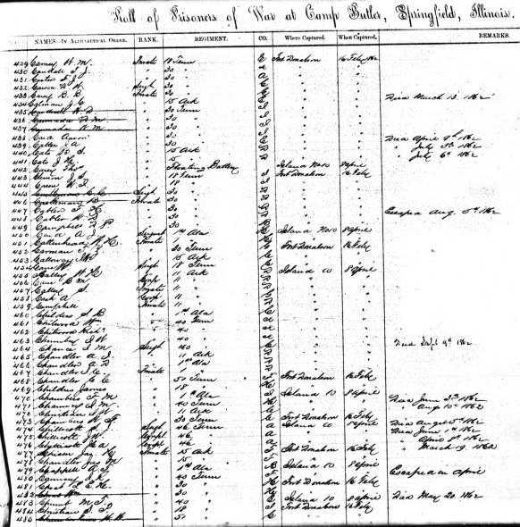
Ancestry Library Edition contents
Military Records
Nearing 400 data sets
200M+ U.S. records from the Colonial era to Vietnam
Foreign military records
  Canada (10 data sets w/ 4 million+ records)
  Europe (80 data sets w/ 30 million+ records)

Slide 10
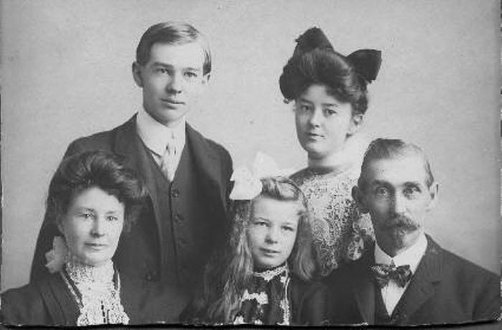
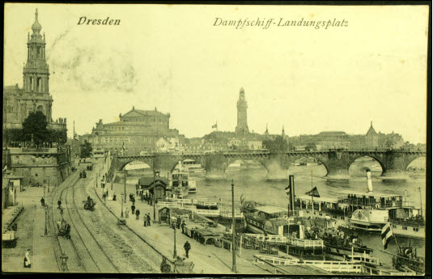
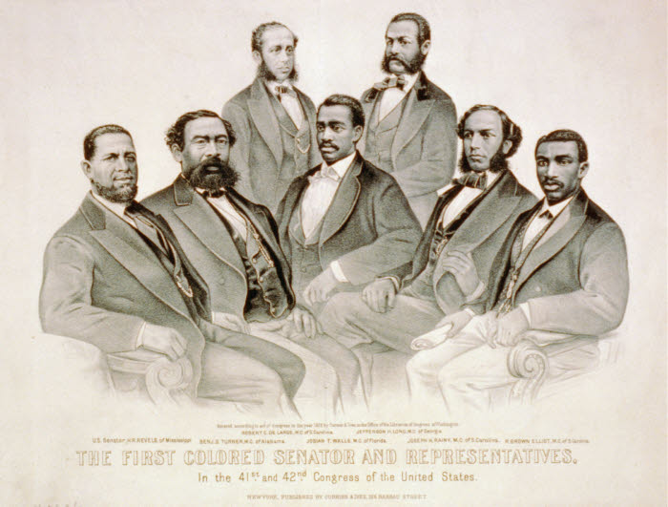
Other Notable Data
Diverse International Collections
  46M+ files from German census, vital records, emigration indexes, ship lists, phone directories, and more; 12+ Mexican data sets; Chinese Surname Index for the Jiapu Collection of Chinese lineage books; Jewish family history records from Eastern Europe and Russia; and more.
More than 3,700 Stories, Memories, & Histories
Holocaust-specific records
  40+ data sets w/ ~4 million records
  Found in various categories:
    Military
    Birth, Marriage, & Death
    Stories, Memories, & Histories
    Immigration & Travel
    Schools, Directories, & Church Histories
    Tax, Criminal, Land, & Wills

Slide 11
African American, American History, & Slavery Collections
African American Photo Collection, 1850 – 2000
Abraham Lincoln Papers
Professional Baseball Players, 1876 - 2004
US Interviews with Former Slaves, 1936 - 1938
New Orleans, Louisiana, Slave Manifests, 1807-1860
US Southeast Coastwise Inward & Outward Slave Manifests, 1790 – 1860
Mississippi, Wilkinson County Newspaper Slave Ads, 1823 – 1849
Slave Registers of Former British Colonial Dependencies, 1812 – 1834
Louisiana Freed Slave Records, 1719 – 1820
Louis Hughes, Thirty Years a Slave, 1832 – 1862

Slide 12
Search Tips
The wildcard character (*) will account for various name endings, up to 5 extra characters. For example, searching Char* will return hits on names like Charles, Charley, Charlie, Charlene, or Charlotte and any other names beginning with the letters Char. Note that you must type in at least the first three letters of the name before putting in the wildcard.
The truncation symbol (?) is used when you only want one letter of a name to be different. If you are trying to find the name Hansen that was also sometimes spelled Hanson, you could type in Hans?n to find both variants. Note that you must type in at least the first three letters of the name before putting in the wildcard.

Slide 13
One more search tip…
When searching Keywords, try using quotation marks around two or more terms (e.g., “civil rights,” “World War II,” or “The Great Depression”) to aid in the precision of the search, ultimately retrieving more accurate results.

Slide 14

Demonstration

Slide 15
Questions?
Feel free to contact us!
  More information is available online!
    http://www.proquest.com/en-US/catalogs/databases/detail/ale.shtml
  Contact your Account Representative
  http://www.proquest.com> Find An Account Rep link
  Contact your Customer Education & Training Specialist http://www.proquest.com> Support & Training tab
  ProQuest Support Center http://support.proquest.com/display/4n/search.asp?tab=search
  Directly request consideration of content submission via Ancestry group:
    Yearbooks: http://landing.ancestry.com/yearbook/submission.aspx
    All other content: http://tinyurl.com/y9sjtnv

Slide 16
Questions:
Reference reference@elmhurst.org

